Slide 1
Transition to Adult Health
Michelle Maeda, MS, RD
Children with Special Health Needs Program

Slide 2
Pediatric Adult
Pediatrician/Family practice
Family Centered
Longer visits
Central Pediatric Hospital
Few Pediatric Specialists
Most affiliated with Peds Hosp
Centralized Electronic Medical Record
Internal Medicine/Family Practice
Patient Centered
Shorter visits
Many Adult Hospitals
Straub
Queens
Pali Momi
Kuakini
Many Adult Specialists
May or May not be affiliated with all above hospitals
Multiple Electronic Medical Records

Slide 3
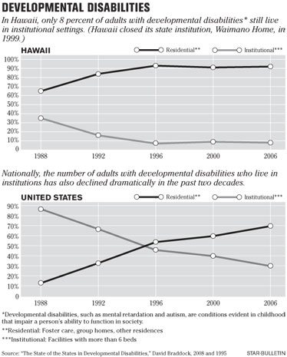

Slide 4
Pediatric versus Adult Specialists
Hypoplastic Left Heart Syndrome
Tetrology of Fallot
Dextrocardia
Double inlet L ventricle
Coronary Artery Disease
Heart Attacks
Atrial fibrillation
Congestive Heart Failure

Slide 8
References and Resources
Got Transition. www.gottransition.org copyright 2014-2023
Children’s Hospital of Philadelphia. Transition to Adulthood Services Resources. https://www.chop.edu/centers-programs/transition-adulthood-services/health-resources
Oregon ISP. One Page Profiles. https://oregonisp.org/1ppa/
Teen Link Hawaii. Transition to adult health. https://www.teenlinkhawaii.org/transition-to-adult-healthcare

